Slide 1
64 bits best practices and advices Part 1/2 - Types

Slide 2
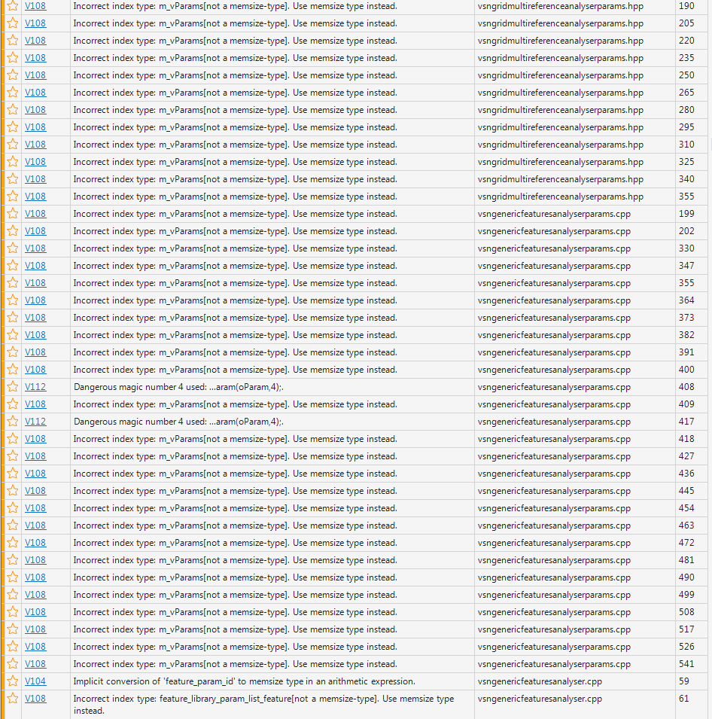
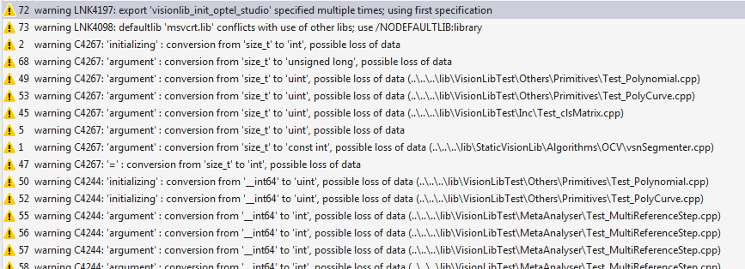
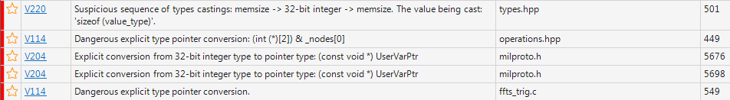
Building the VisionLib in 64bits
Integer types:
~99% of ~500 build warnings in Visual Studio
~95% of ~12500 warnings found with PVS-Studio

Slide 3
Integral types…
DWORD
INTPTR
SIZE_T
__int32
intptr_t
uintptr_t
time_t
int
SSIZE_T
short
unsigned int
uint
unsigned long
size_t
long
long long
DWORD_PTR
ptrdiff_t
unsigned long long
__int64

Slide 4


Integral types: how to choose ?
 | 32 bits | 64 bits
int | 4 bytes | 4 bytes
unsigned int (uint) | 4 bytes | 4 bytes
long | 4 bytes | 4 bytes
unsigned long | 4 bytes | 4 bytes
size_t | 4 bytes, __w64 unsigned int | 8 bytes, unsigned __int64
intptr_t | __w64 int | __int64
uintptr_t | __w64 unsigned int | unsigned __int64
ptrdiff_t | __w64 int | __int64
DWORD | unsigned long | unsigned long
DWORD_PTR (ULONG_PTR) | __w64 unsigned long | unsigned __int64
SSIZE_T (LONG_PTR) | __64 long | __int64

Slide 5
memsize type
“memsize” means any simple integer type which is capable of keeping a pointer, and changes its size according to the change of platform from 32-bit to 64-bit. For example, memsize types are:
size_t
ptrdiff_t
all pointers
intptr_t
INT_PTR
DWORD_PTR.
size_t also prevents from having array[-1], but…
https://www.viva64.com/en/a/0004/#ID0EVQCK

Slide 6
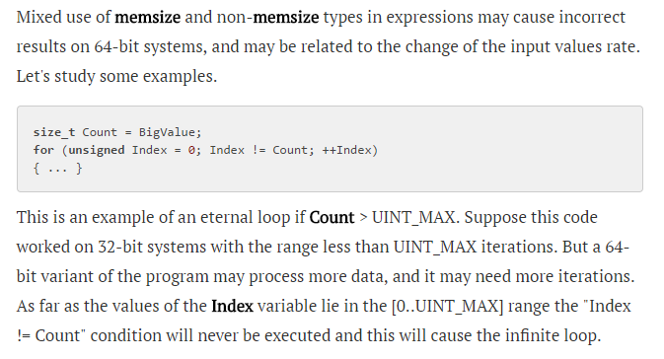
Mixed use of simple integer types and memsize types [14]
https://www.viva64.com/en/a/0004/#ID0EZ5EK

Slide 7
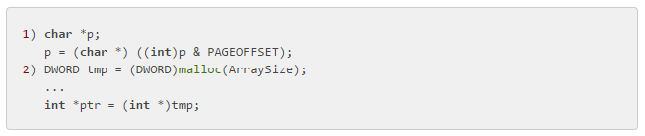
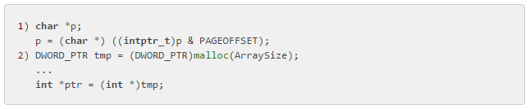
Storing of pointer adresses [6]
Explicit type conversion which eventually truncates high bits in the pointer
One should use only memsize types for the integer form of pointers.
The uintptr_t type is more preferable since it shows programmer's
intentions more clearly, and makes the code more portable,
saving it from future changes
https://www.viva64.com/en/a/0004/#ID0EHZBI

Slide 8
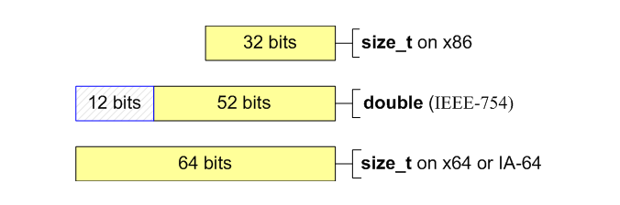

Storing integers in double type [4]
In any case it is not recommended to mix integer arithmetic with floating-point arithmetic.
https://www.viva64.com/en/a/0004/#ID0EBUAI

Slide 9

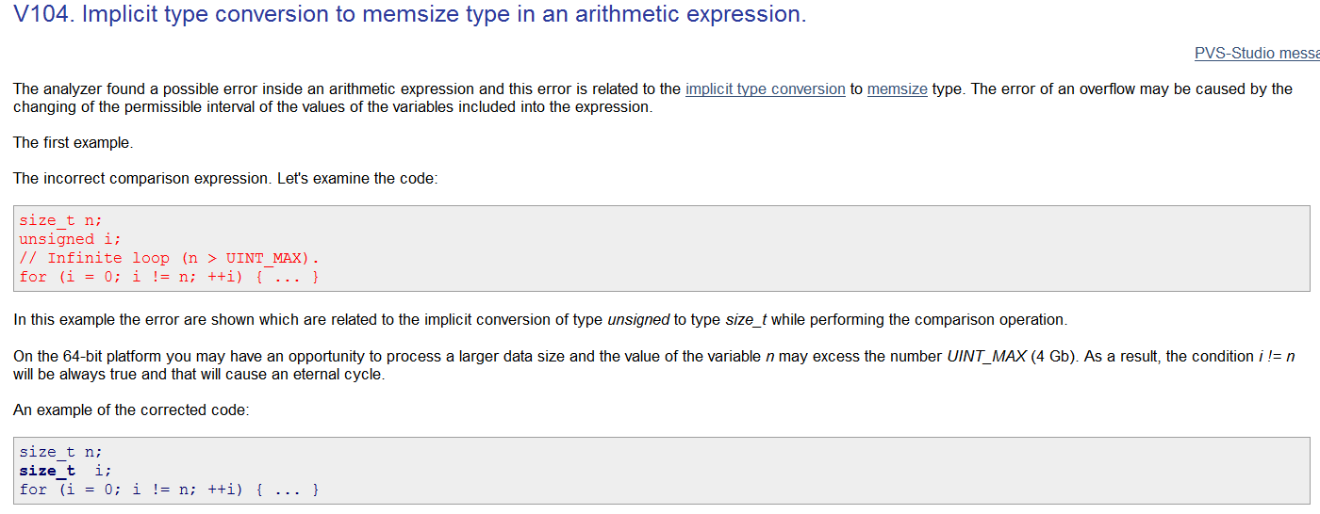
PVS Studio diagnostic example

Slide 10
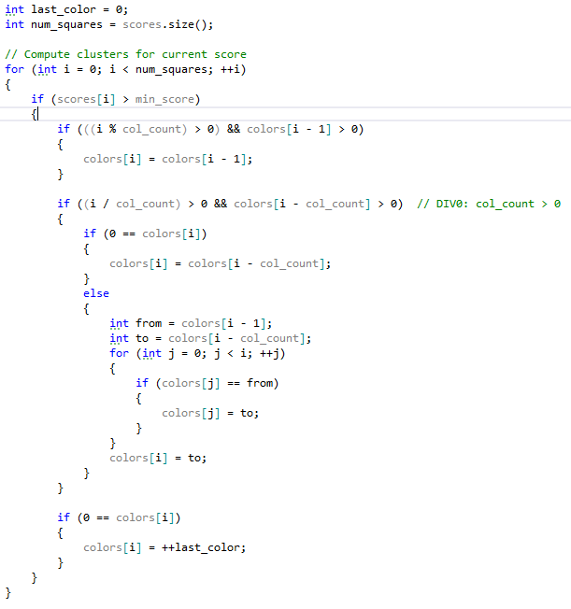
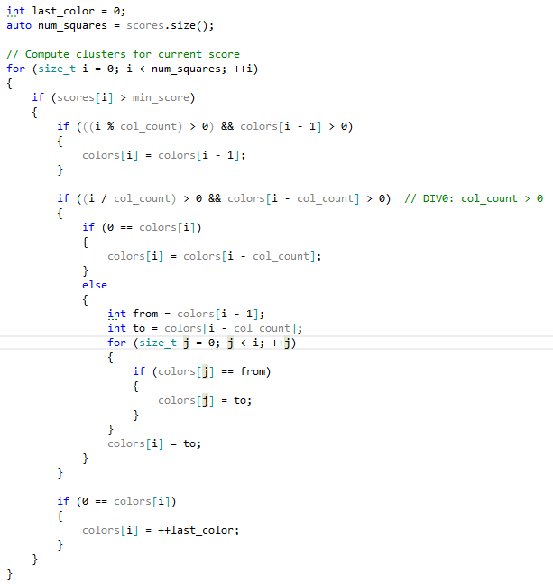
A simple example

Slide 11
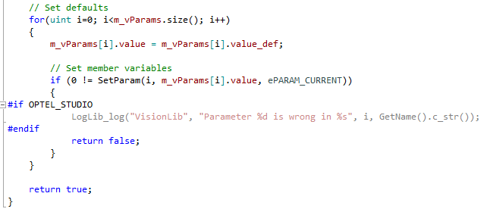
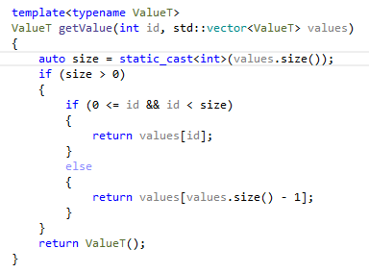
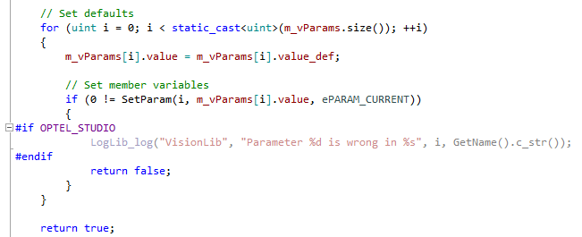
Change function signatures only if necessary…

Slide 12
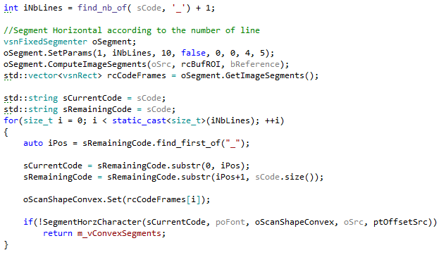
Change function return type only if necessary…

Slide 13
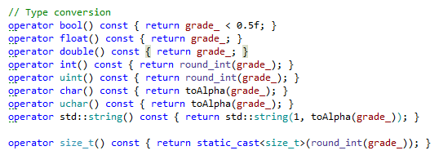
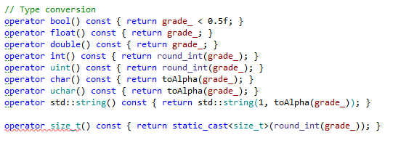

When coding for 64 bits, keep 32 bits in mind !
Valid 64 bits code ☺
Invalid 32 bits code ☹

Slide 14
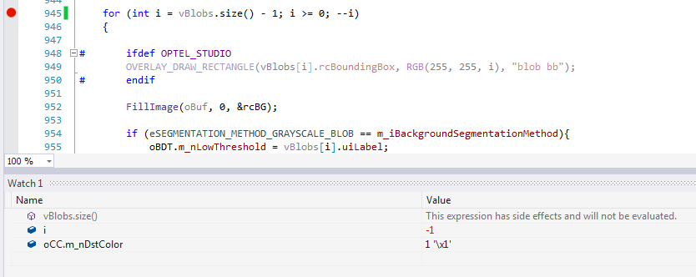
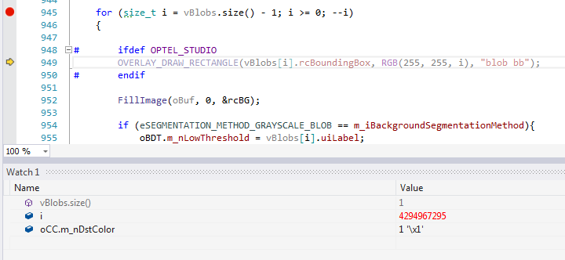
Remember array[-1] ?
FullLabelAnalyser.cpp

Slide 15

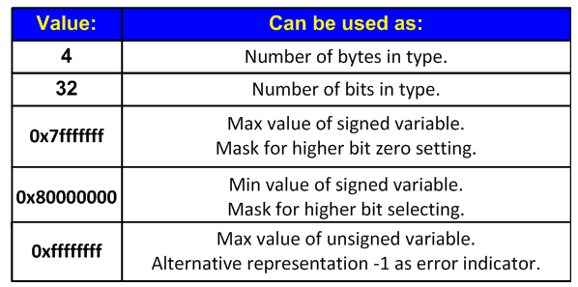

Magic numbers [3]
Low-quality code often contains magic numbers, the mere presence of which is dangerous.
During the migration of the code onto the 64-bit platform, these magic numbers may make
the code inefficient if they participate in calculation of address, object size or bit operations.
https://www.viva64.com/en/a/0004/#ID0E5DBG

Slide 16
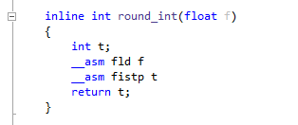
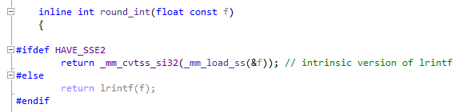
Assembler
Assembler code is not supported in 64 bits
When the use of assembler or XMM registers is needed, use intrinsics functions:

Slide 17

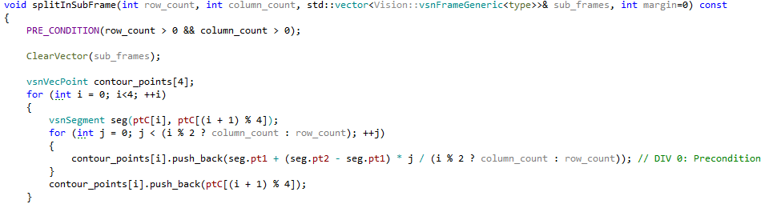
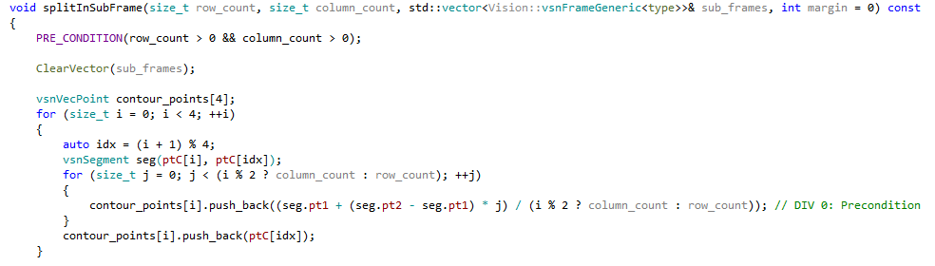
UOFs :Unidentified OverFlows
OVERFLOW !

Slide 18
Use of container size_type for indices
As suggested by Marc Bouthot, one may use the size_type static attribute instead of size_t&Co in iterations. This will prevent from having overflows and compiler complaints. For example:
for (vector<int>::size_type ix = 0; ix ! = ivec.size(); ++ix) { ivec[ix] = 0; }

Slide 19
Advices for conversion to 64 bits: summary
Always prefer memsize types, like intptr_t and uintprt_t
Avoid mixing memsize types and non-memsize types (in comparison for examples)
Look at the use of a variable before changing its type. Quite obvious, but we all get tired at the end of the day…
Always prefer explicit conversion over implicit
Avoid changing function signatures
Avoid changing function return type
Reduce at maximum the changes and focus on code migration, not on code improvement

Slide 20
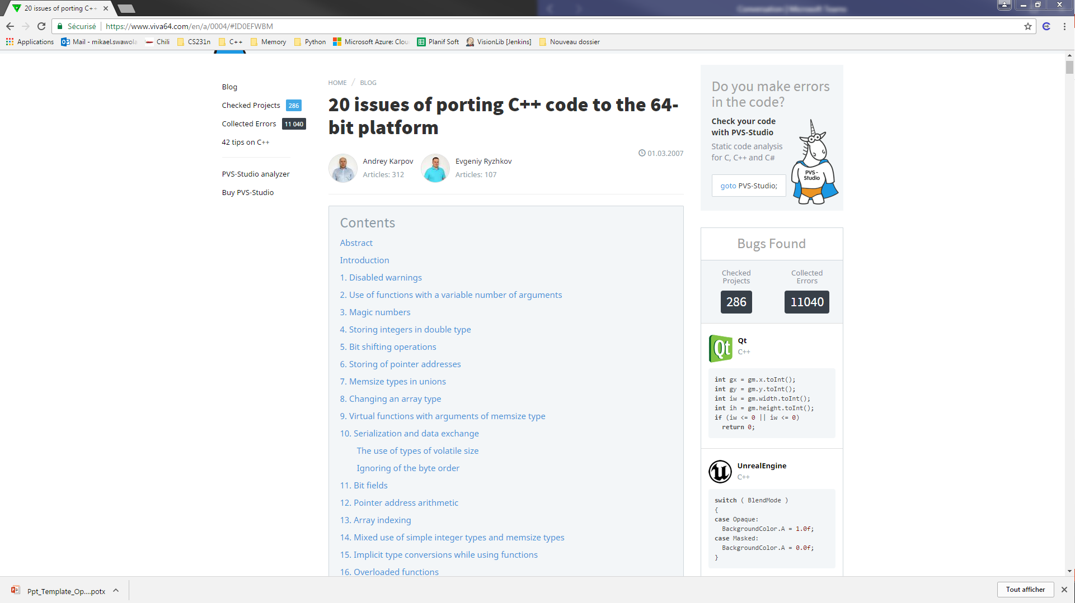
viva64

Slide 21


Predefined Macros (VS2013)

Slide 22
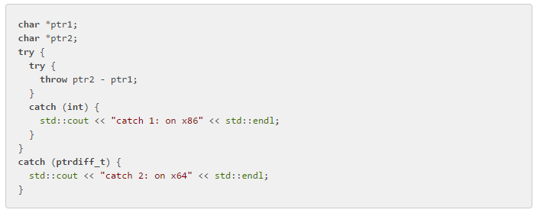

Exceptions [18]
Never do that !
https://www.viva64.com/en/a/0004/#ID0EBHBM

Slide 23
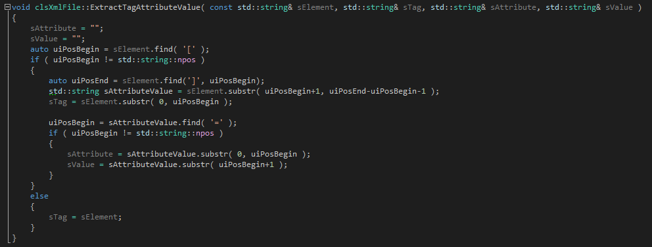
Works fine in 32 bits, bugs in 64 bits. Why ?

Slide 24
Code vectorization and the use of Eigen

Slide 25
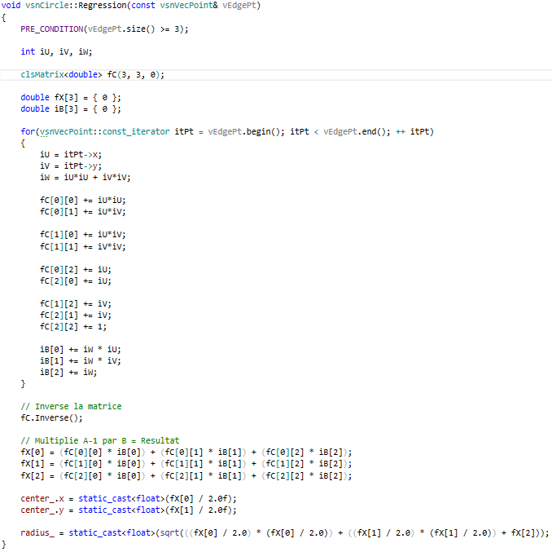
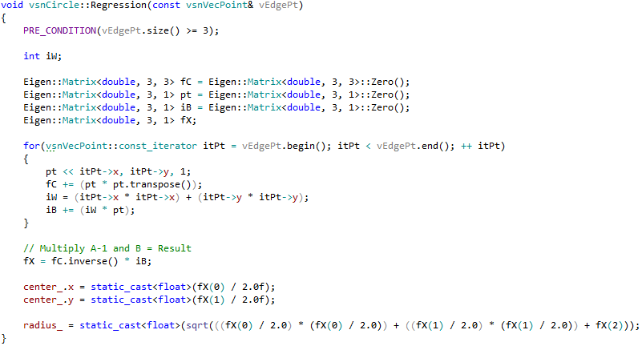
Code vectorization and the use of Eigen
TODO: Use Eigen::Matrix or Eigen::Vector instead of vsnVecPoint

